Slide 1
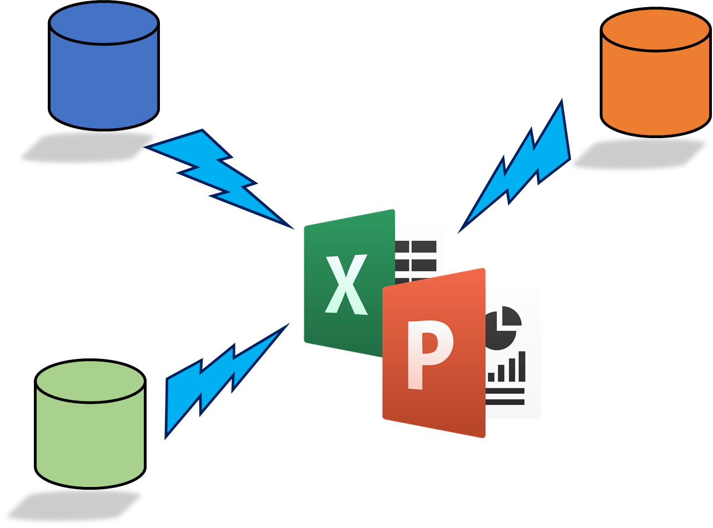
火箭报表模块V2.2 Rocker Reporting V2.2
安装向导说明
15.2.2021

Slide 2

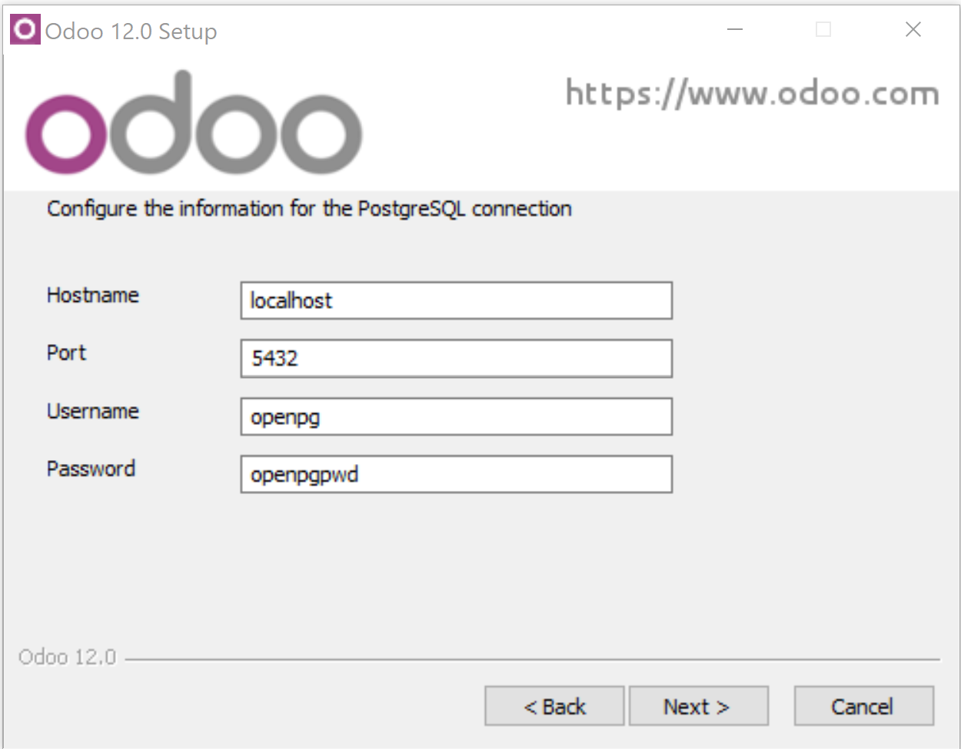
必须安装Windows版的Odoo 12 或 Odoo 13
由于模块依赖于 Win32Com 因此必须 Windows 平台的odoo 12或odoo13
下边是下载链接：
https://www.odoo.com/page/download
https://nightly.odoo.com/
本人使用的操作系统是个人版 Windows 10 Pro
右边是Odoo12的exe安装界面截图：

Slide 3
如何验证 pywin32 已经安装了呢？
添加路径 | 将python\Scripts修改添加到系统环境变量
修改为 | 变更python/Scripts目录"c:\Program Files (x86)\Odoo 12.0\python\Scripts"
执行pip | 执行pip安装pywin32依赖 "c:\Program Files (x86)\Odoo 12.0\python\Scripts>pip install pywin32"
默认情况下，已安装win32com
(检查 Odoo 12, 13 & 14)
已满足要求： pywin32 在 c:\program files (x86)\odoo 12.0\python\lib\site-packages (227)
(注意: 要以管理员身份运行cmd命令提示符)

Slide 4
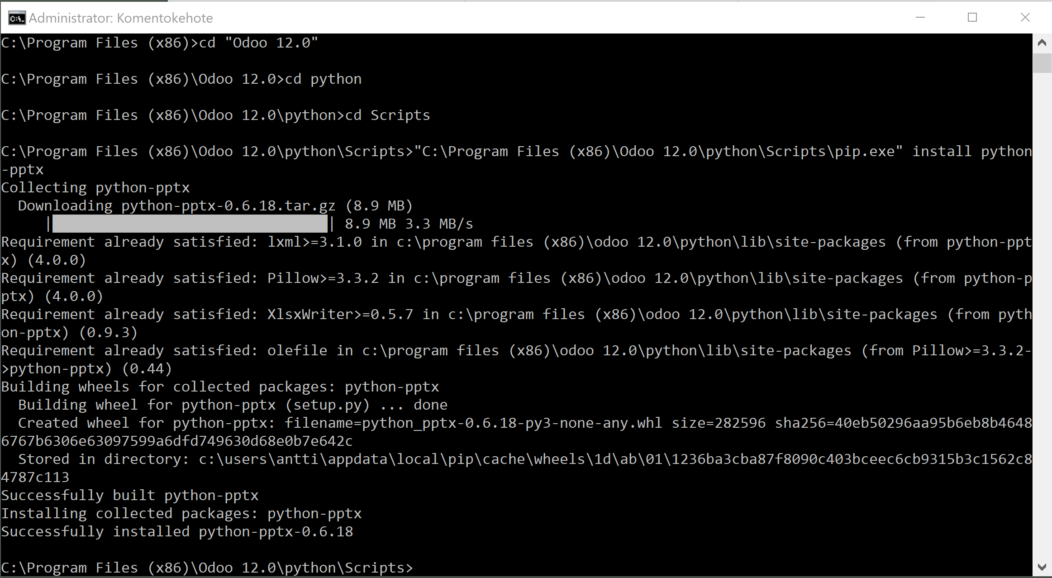
PowerPoints: 安装依赖 python-pptx
中国大陆加速：
D:\Program Files (x86)\Odoo 13.0\python>python.exe -m pip install python-pptx -i
https://pypi.tuna.tsinghua.edu.cn/simple
以管理员身份运行cmd
执行以下命令 (以Odoo 13以为例):
"C:\Program Files (x86)\Odoo 13.0\python\python" "C:\Program Files (x86)\Odoo 13.0\python\Scripts\pip.exe" install python-pptx
或者假如你的python已经添加到系统
环境变量里的话可以执行以下命令：
“pip install python-pptx”

Slide 5
下载并安装 rocker_app模块
从odoo官方app市场下载得到 rocker_app.zip 压缩查看odoo配置文件odoo.conf中的addons_path路径：
[options]
addons_path = C:\Program Files (x86)\Odoo 12.0\server\odoo\addons
将rocker_app.zip压缩包解压 (解压到文件夹)
复制 rocker_app 文件夹到 C:\Program Files (x86)\Odoo 12.0\server\odoo\addons目录下
重启 Odoo 服务
或 Odoo 13.0

Slide 6
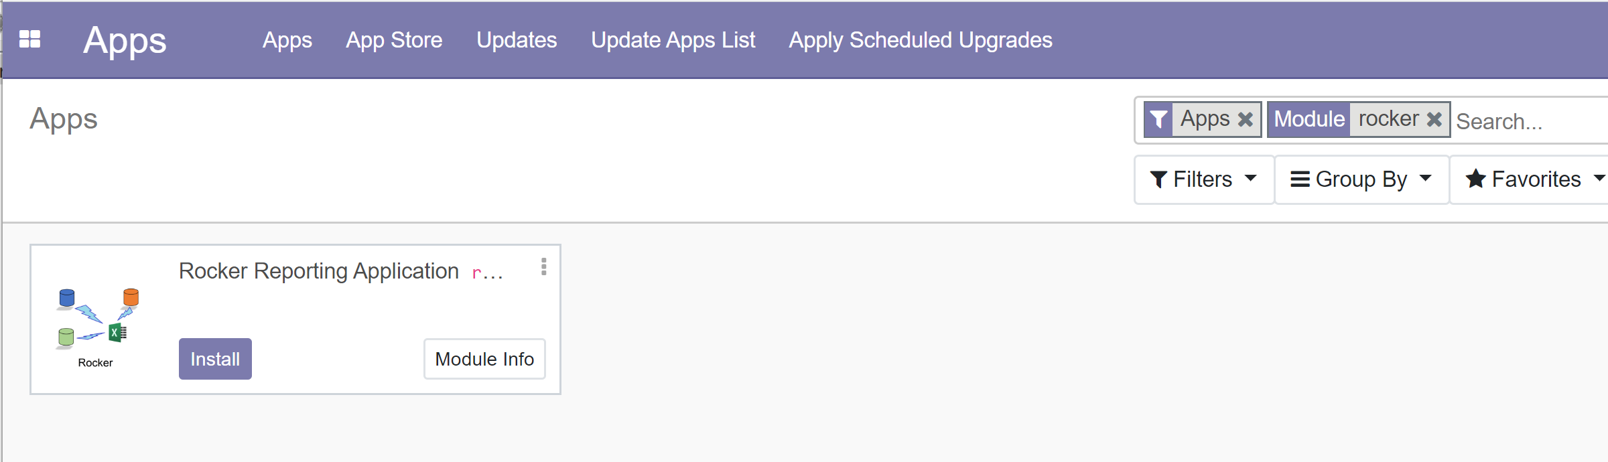
安装 Rocker 模块
在odoo中激活开发者模式
刷新本地模块列表
搜关键字 Rocker
点击安装

Slide 7
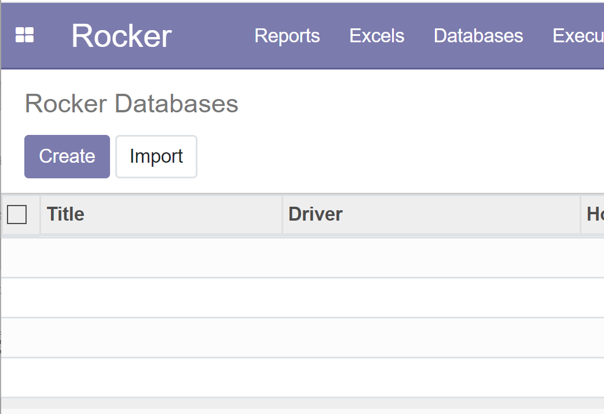
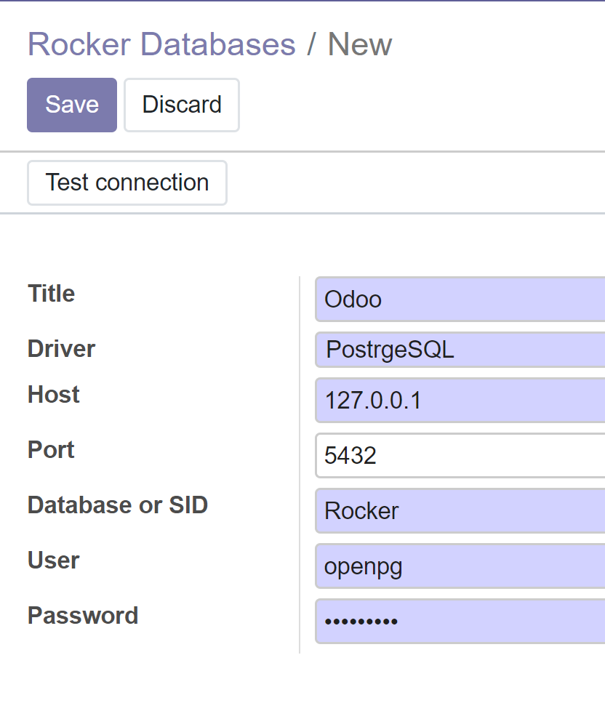
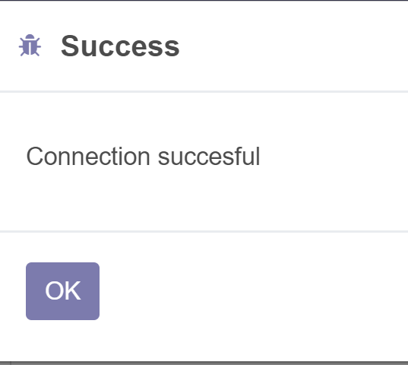
为PostgreSQL ( Odoo)创建数据库/数据源
在下拉菜单中选择数据库
点【创建】…
选 PostgreSQL driver, 填数据库名称 & 或其他必填字段
点【保存】
点【连接测试】，弹出连接成功

Slide 8
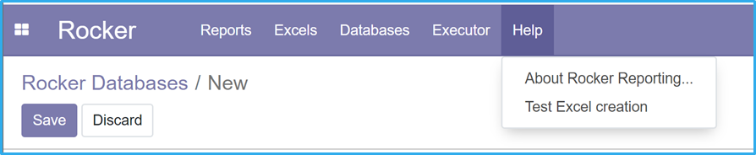
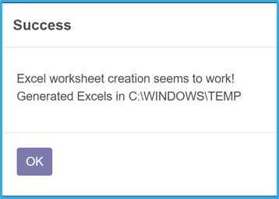
测试 Excel 功能
准备好:服务器必须安装有32位的Excel程序软件
I not working you should:
Create folder C:\Windows\SysWOW64\config\systemprofile\Desktop ( or C:\Windows\System32\config\systemprofile\Desktop if 32-bit windows)
Reboot after folder creation, check access rights
If you don’t do this, you’ll get exception from Workbook.SaveAs or Open command
Execute “Test Excel creation” from Help menu
32 bit Excel needed, otherwise win32api can not call Excel from Odoo service
If you only have 64 bit Excel, then you have to start Odoo from command prompt (does not work if Odoo runs as a service). (Check something goes wrong slide)
At the moment (15.2.2021) we have a problem starting Excel if Odoon runs as a service Start Odoo from command prompt (see next slide)

Slide 9
Start Odoo from command prompt (cmd)
"C:\Program Files (x86)\Odoo 13.0\python\python.exe" "C:\Program Files (x86)\Odoo 13.0\server\odoo-bin" -c "C:\Program Files (x86)\Odoo 13.0\server\odoo.conf" --log-level=debug
"C:\Program Files (x86)\Odoo 12.0\python\python.exe" "C:\Program Files (x86)\Odoo 12.0\server\odoo-bin" -c "C:\Program Files (x86)\Odoo 12.0\server\odoo.conf" --log-level=debug
"C:\Odoo14\python\python.exe" "C:\Odoo14\server\odoo-bin" -c "C:\Odoo14\server\odoo.conf" --log-level=debug
When everything runs smootly, change logger_level to “info”

Slide 10
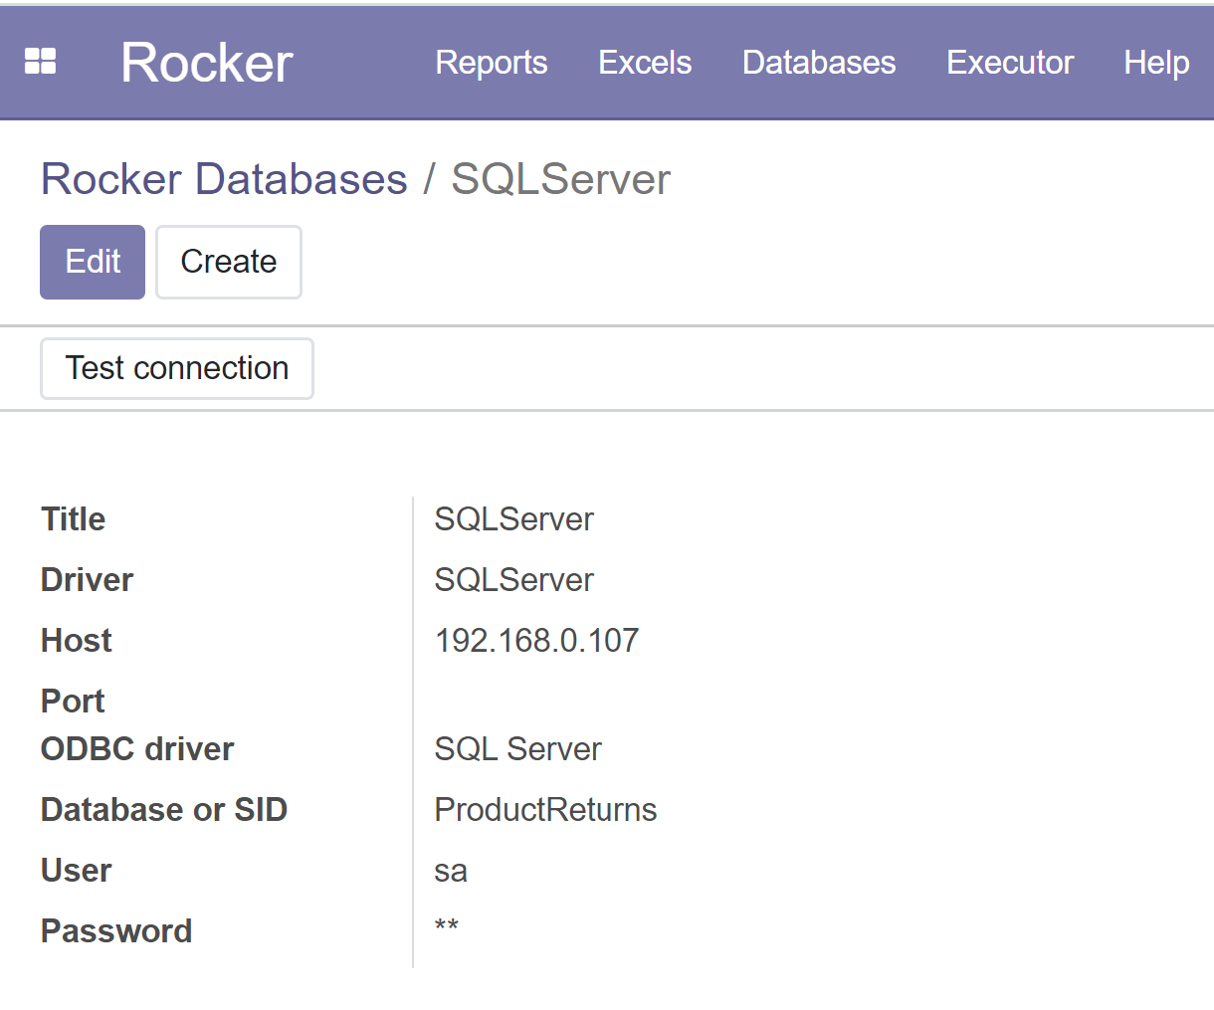
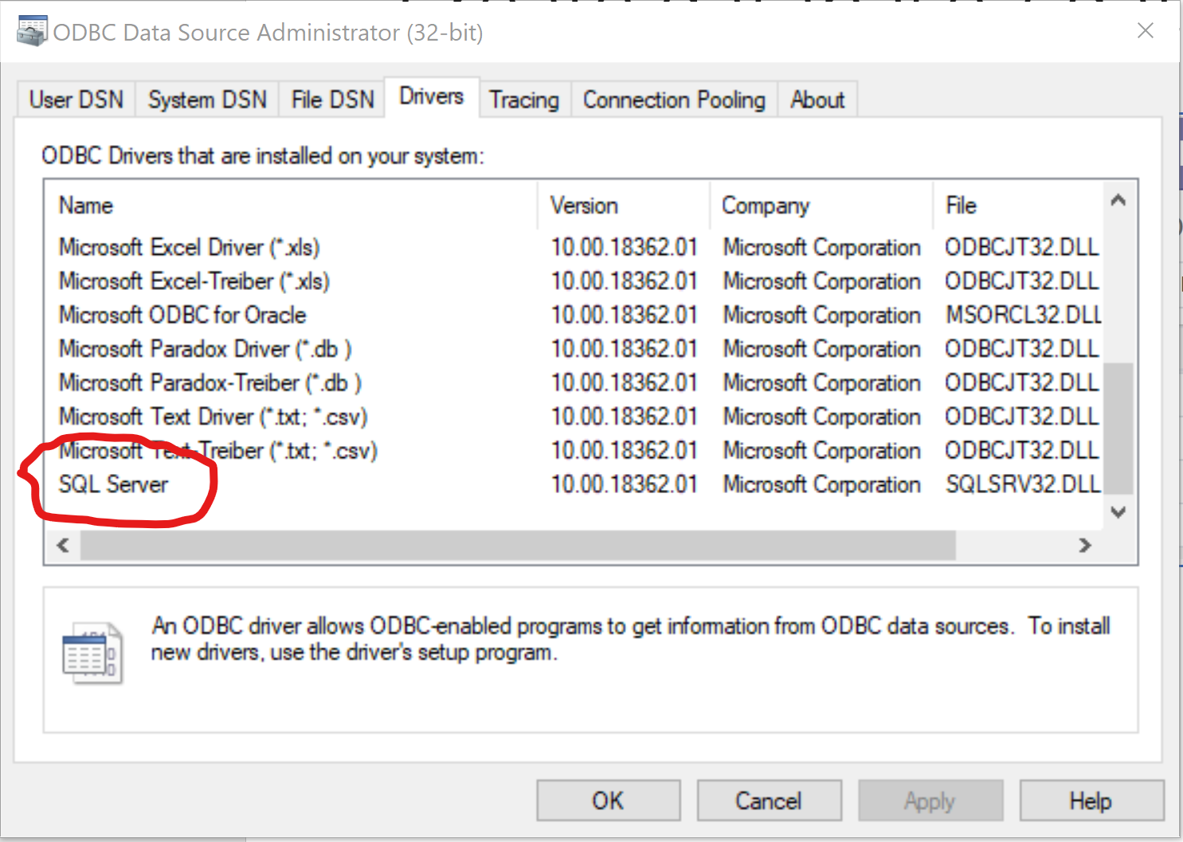
Create database / datasource for SQLServer / ODBC
C:\Program Files (x86)\Odoo 12.0\python\Scripts>pip install pyodbc
Select Databases from menu
Create…
Select SQLServer driver, Change database name & other data when necessary
Save
Test connection

Slide 11
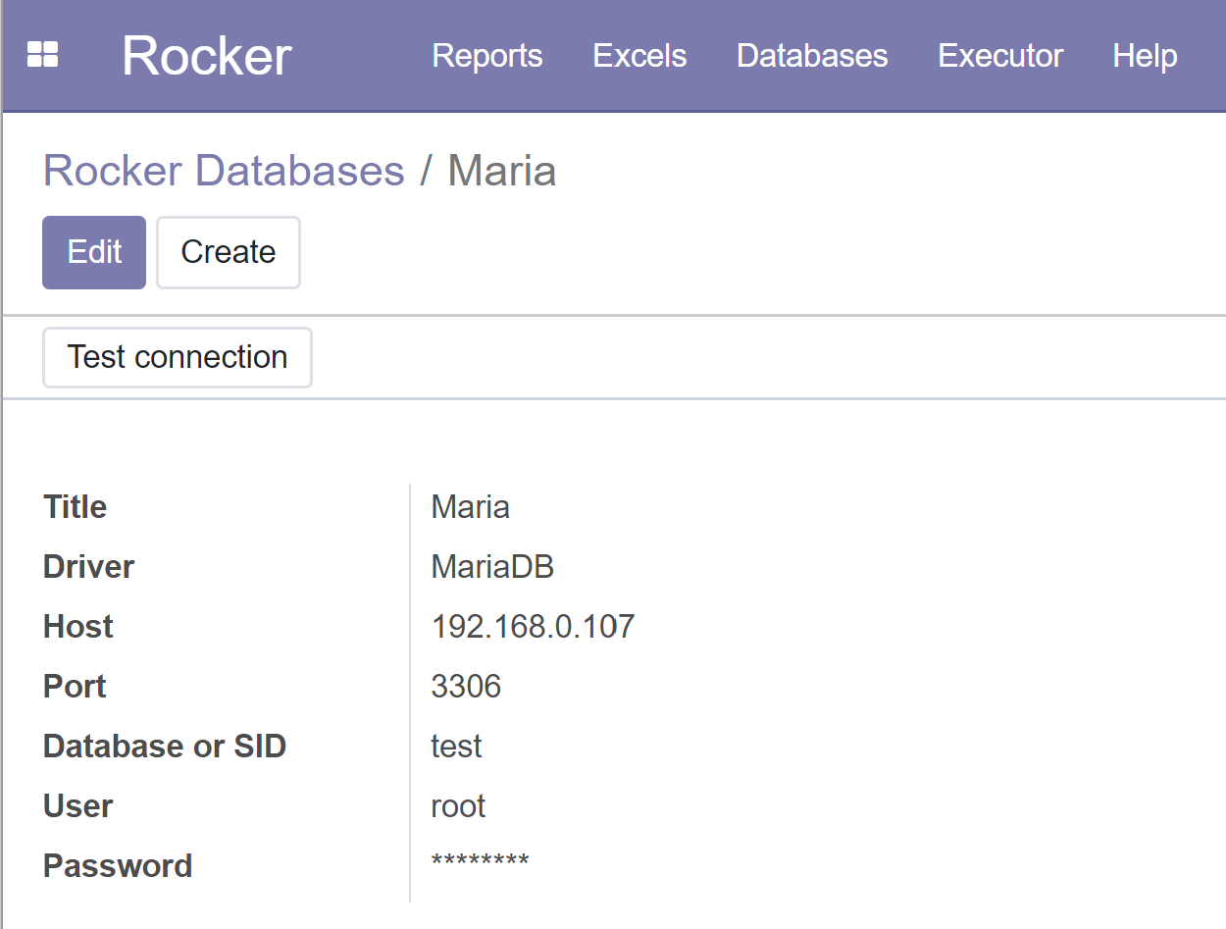
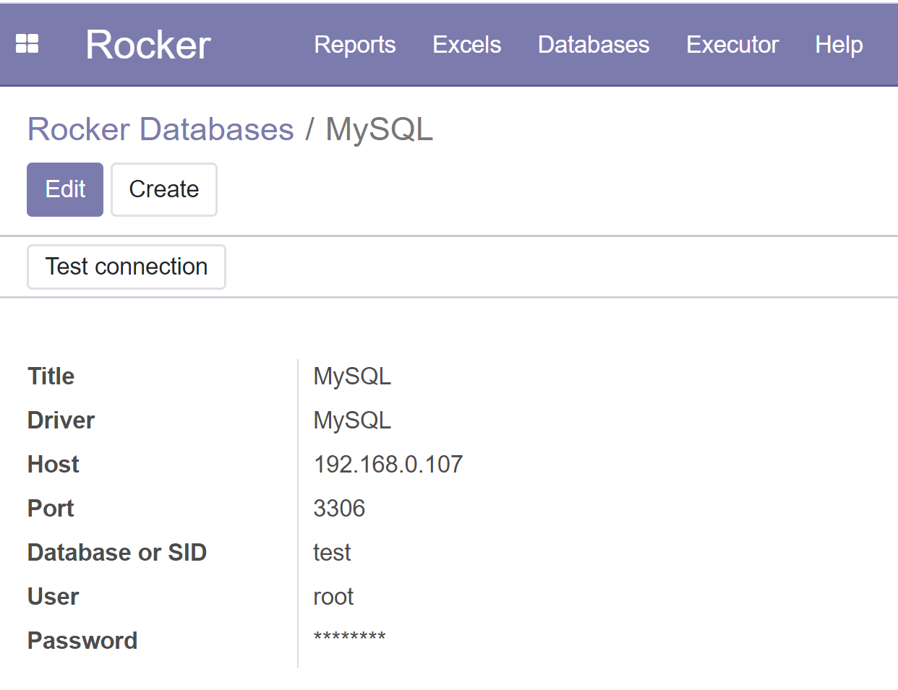
Create database / datasource for MySQL or MariaDB
C:\Program Files (x86)\Odoo 12.0\python\Scripts> pip install mysql-connector-python
Select Databases from menu
Create…
Select MySQL or MariaDB driver, Change database name & other data when necessary
Save
Test connection

Slide 12
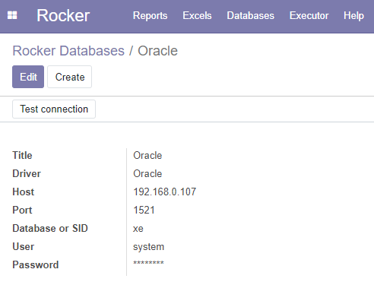
Create database / datasource for Oracle
Download and install Oracle instant client from: https://www.oracle.com/database/technologies/instant-client/downloads.html
Extract file to e.g. C:\Oracle\instantclient_19_5
Add C:\Oracle\instantclient_19_5 to PATH (System variables side)
Install Microsoft Visual C++ Redistributable from https://support.microsoft.com/en-us/help/2977003/the-latest-supported-visual-c-downloads
I installed both 32 & 64-bit
Install python drivers
C:\Program Files (x86)\Odoo 12.0\python\Scripts> pip install cx_Oracle –upgrade
Reboot
Select Databases from menu
Create…
Select Oracle driver, Change SID & other data when necessary
Save & Test connection
https://cx-oracle.readthedocs.io/en/latest/user_guide/installation.html

